Slide 1
LEARNING UNIT 3 · ACTIVITY 3
Customer Care FAQ Chatbot
with RAG
The agent answers only from the brochures — or admits it does not know.
PLATFORM
VECTOR STORE
DURATION
Copilot Studio
Pinecone
90 minutes
Building AI Agents for Work Automation
Tertiary Infotech Academy Pte Ltd · UEN 201200696W

Slide 2
01
Why RAG?
The problem that retrieval solves
LU3 · Activity 3
© 2026 Tertiary Infotech Academy Pte Ltd
2

Slide 3
SCENARIO
The Customer Care Problem
40 times a day
The answer already exists
Memory drifts
Cook & Bake Academy runs 20 courses across two campuses. Two people answer the same questions: how much, how long, where, what level.
It is in the course brochures. Nobody is short of information — somebody has to find the right file, read it, and retype a sentence.
When the team is busy they answer from memory. Last month someone quoted a fee that was six months out of date.
A language model could answer all of this — if it had ever seen the brochures.
LU3 · Activity 3
© 2026 Tertiary Infotech Academy Pte Ltd
3

Slide 4
THE NAIVE APPROACH
Why Not Just Paste the Brochures In?
Paste all 20 into the prompt
Retrieve only what is needed
Works today, with 20 short brochures.
Then the academy adds 40 more courses.
The prompt exceeds what the model can read.
It starts ignoring the middle of long input.
Every question costs the price of 60 brochures.
Search for the 3 brochures that resemble the question.
Send only those.
Cost stays flat as the catalogue grows.
The model reads 3 documents carefully instead of 60 badly.
This is RAG.
RAG is not a smarter model. It is a smaller, better-chosen prompt.
LU3 · Activity 3
© 2026 Tertiary Infotech Academy Pte Ltd
4

Slide 5
Retrieval Augmented Generation
Retrieve the few documents that answer the question, then let the model generate an answer from those and nothing else.
LU3 · Activity 3
© 2026 Tertiary Infotech Academy Pte Ltd
5

Slide 6
CLEARING THREE MISCONCEPTIONS
What RAG Is Not
Not fine-tuning
Not a database query
Not a guarantee
No training. No model weights change. You are choosing what goes in the prompt, not rebuilding the model.
There is no exact match. You ask for the nearest meanings, and you always get results — even for a question nothing answers.
Retrieval supplies facts. Only the instruction stops the model adding its own. Both halves are required.
If you remember one thing: RAG changes the prompt, not the model.
LU3 · Activity 3
© 2026 Tertiary Infotech Academy Pte Ltd
6

Slide 7
02
How It Works
Tokens, embeddings, dimensions, similarity
LU3 · Activity 3
© 2026 Tertiary Infotech Academy Pte Ltd
7

Slide 8
CONCEPT 1 OF 4
Step 0 — Tokenization: How a Model Reads Text
1
A model never sees letters — it sees tokens
Text is split into pieces of roughly ¾ of a word. "sourdough" might be two tokens: "sour" + "dough".
2
Everything is counted in tokens
Context limits, pricing and speed are all measured in tokens — not words, not characters.
3
A rule of thumb for English
1 token ≈ 4 characters ≈ ¾ of a word. One 2,700-character brochure is roughly 700 tokens.
4
Why this matters for RAG
20 brochures ≈ 14,000 tokens in every prompt. Retrieve 3 instead and you send ~2,100 — the same answer for a seventh of the input.
Tokenization is why "just paste everything in" has a ceiling, and why retrieval saves money.
LU3 · Activity 3
© 2026 Tertiary Infotech Academy Pte Ltd
8

Slide 9
CONCEPT 1, MADE CONCRETE
Tokenization, On One Real Sentence
The sentence a customer typed
Why you should care
“How much is the sourdough course?”
The model does not see 7 words. It sees 8 tokens:
How | much | is | the | sour | dough | course | ?
“sourdough” is rare enough that the tokenizer splits it into two familiar pieces.
Punctuation counts — the “?” is a token of its own.
Tokens are the unit of BILLING. Not words, not characters.
Tokens are the unit of the CONTEXT LIMIT. “Too long” is measured here.
Rare words cost more. A brochure full of “viennoiserie” and “sashimi” splits into more pieces than one about “bread”.
English ≈ 4 characters per token. A 2,700-character brochure is ~700 tokens; twenty of them ~14,000 — in every prompt, if you paste them all in.
Count the tokens in your own text at platform.openai.com/tokenizer — the split is often surprising.
LU3 · Activity 3
© 2026 Tertiary Infotech Academy Pte Ltd
9

Slide 10
CONCEPT 2 OF 4
Step 1 — Embedding: Turning Text Into Coordinates
1
Text in, numbers out
An embedding model converts a piece of text into a fixed-length list of numbers — a vector.
2
Position encodes meaning
The model places text so that similar meanings land near each other. This is learned, not programmed.
3
Same model, every time
Brochures and questions must be embedded by the SAME model, or the coordinates are not comparable.
4
In this lab it is invisible
Pinecone's hosted model (llama-text-embed-v2) embeds server-side. You send text, not numbers.
An embedding is a position in meaning-space. Nothing more mysterious than that.
LU3 · Activity 3
© 2026 Tertiary Infotech Academy Pte Ltd
10

Slide 11
CONCEPT 2, MADE CONCRETE
Embedding, On Four Real Phrases
1
"How much is the sourdough course?"
→ [0.021, −0.184, 0.077, … ] 1024 numbers. Lands in the bread region of meaning-space.
2
"What does BAK-101 cost?"
→ [0.019, −0.176, 0.081, … ] Almost the SAME numbers — different words, same meaning.
3
"How much is the sushi course?"
→ [−0.203, 0.115, −0.042, … ] Very different numbers. One word changed; the meaning moved.
4
"sourdough" (the word alone)
→ near the first two, but not identical. A word and a question about that word are related, not the same.
Rows 1 and 2 share almost no letters and nearly all of their meaning. That gap is exactly what keyword search cannot cross.
LU3 · Activity 3
© 2026 Tertiary Infotech Academy Pte Ltd
11

Slide 12
CONCEPT 3 OF 4
Semantic Search: Near Means Similar
bread making
brochure
What the picture shows
sourdough
brochure
The question lands next to the sourdough brochure and far from the sushi one — even though the question and the brochure share almost no words.
A keyword search would need the exact word. A vector search needs only the meaning.
Real embeddings do this in 1024 dimensions, not 2. You cannot draw that, but the idea is identical: near = similar.
"how much is the
sourdough course?"
sushi
brochure
sashimi
brochure
Distance here = difference in meaning, not in spelling.
This is why a customer who misspells “viennoiserie” still finds BAK-102.
LU3 · Activity 3
© 2026 Tertiary Infotech Academy Pte Ltd
12

Slide 13
CONCEPT 3, CONTINUED
Keyword Search vs Vector Search
Keyword search — matches characters
Vector search — matches meaning
“viennoiserie” misspelt → zero results.
“french pastry classes” → no match, because the brochure never uses the word “classes”.
Finds documents that contain your letters.
Fails silently on synonyms, plurals and typos.
“vienoiserie” (misspelt) → still finds BAK-102.
“french pastry classes” → finds BAK-102 French Pastry & Viennoiserie.
Finds documents that mean what you asked.
Always returns something — even for a question nothing answers.
That last line cuts both ways: vector search never says “no results”. Guarding against a confident answer built on a poor match is the instruction's job.
LU3 · Activity 3
© 2026 Tertiary Infotech Academy Pte Ltd
13

Slide 14
CONCEPT 4 OF 4
Step 2 — Dimension: How Many Numbers
1
The dimension is the length of the vector
llama-text-embed-v2 produces 1024 numbers per piece of text. Gemini's gemini-embedding-001 produces 3072.
2
More dimensions ≠ better
It is a different model with a different trade-off between nuance, storage and speed. Not a quality dial.
3
The index is fixed at one dimension
An index built for 1024 accepts 1024-length vectors and nothing else.
4
The rule you cannot break
ingestion model == query model == the index's dimension. All three, or the search is meaningless.
Break rule 4 and you get either a loud error or — far worse — quietly poor results.
LU3 · Activity 3
© 2026 Tertiary Infotech Academy Pte Ltd
14

Slide 15
FAILURE MODES
The Two Ways Dimension Bites You
Loud failure — you will notice
Silent failure — you will not
A 1536-dim query against a 3072-dim index.
Pinecone rejects it with an error naming both numbers.
Annoying, but it stops you immediately.
Fixed in five minutes.
Both models give 3072 numbers — but they are different models.
The index accepts every vector. No error, ever.
Retrieval just returns slightly wrong brochures, forever.
This is the one that reaches production.
Gemini also needs taskType RETRIEVAL_DOCUMENT when ingesting and RETRIEVAL_QUERY when searching. Both return 3072 numbers, so getting it wrong throws no error at all.
LU3 · Activity 3
© 2026 Tertiary Infotech Academy Pte Ltd
15

Slide 16
THE SETTING THAT DECIDES QUALITY
Step 3 — Chunking: The Biggest Lever
1
A chunk is the unit that gets embedded and returned
Search does not return “a document”. It returns whichever chunk matched.
2
Chunk too small: 1,000 characters
A 2,700-character brochure becomes 3 fragments. The fragment saying “sourdough” is not the fragment saying “S$680”.
3
The result is an honest, useless answer
Retrieval finds the sourdough fragment. The agent never sees the fee. It tells the customer it does not know the price. No error is raised.
4
This lab: one brochure = one chunk
2,700 characters, well within the model's 2,048-token limit. One search returns the code, the fee, the duration and the campus together.
The rule: a chunk is the smallest piece of text that still answers a question on its own. For a brochure that is the whole brochure. For a 400-page manual it is not.
LU3 · Activity 3
© 2026 Tertiary Infotech Academy Pte Ltd
16

Slide 17
PUTTING THE FOUR CONCEPTS TOGETHER
The RAG Pipeline, End to End
20 brochures
Embed
Store
Search
Generate
SharePoint
the source of truth
each brochure →
1024 numbers
Pinecone index
20 vectors
question → vector
→ 3 nearest
agent answers from
those 3 only
The first three run ONCE (ingestion). The last two run on EVERY question (retrieval). That split is why RAG is cheap to operate and slow to set up.
LU3 · Activity 3
© 2026 Tertiary Infotech Academy Pte Ltd
17

Slide 18
03
The Build
Five nodes, one flow
LU3 · Activity 3
© 2026 Tertiary Infotech Academy Pte Ltd
18

Slide 19

THE DELIVERABLE
What You Are Building
The academy's website. The 💬 button opens a chat widget that posts to your flow.
LU3 · Activity 3
© 2026 Tertiary Infotech Academy Pte Ltd
19

Slide 20
COPILOT STUDIO · LAB 3 - RAG
One Flow, Five Nodes
Trigger
HTTP
Compose
Agent
Response
HTTP request
the question
POST to Pinecone
retrieval
question +
brochures
writes the
answer
{ reply }
back to browser
Plus Task 1, which ran once before any of this existed: create the index, upload the 20 brochures as text. Notice there is no embeddings node — Pinecone hosts the model.
LU3 · Activity 3
© 2026 Tertiary Infotech Academy Pte Ltd
20

Slide 21
RUN ONCE, BEFORE ANY FLOW EXISTS
Task 1 — Ingest: Create the Index
1
POST /indexes/create-for-model
One call creates a serverless index with an INTEGRATED embedding model — Pinecone hosts the model, so you upload words, not numbers.
2
model: llama-text-embed-v2
1024 dimensions, 2048-token limit. You did not pick the dimension — it is a property of the model.
3
field_map: { text: chunk_text }
THE embedding configuration. It says: embed whatever arrives in the field called chunk_text.
4
Get that name wrong and nothing errors
Records are stored with no vector at all. Retrieval returns nothing, forever, and no log says why.
python3 ingest_brochures.py — the script is 150 commented lines and is the only place in this lab where the embedding decisions are visible.
LU3 · Activity 3
© 2026 Tertiary Infotech Academy Pte Ltd
21

Slide 22
AS TEXT, NOT AS VECTORS
Task 1 — Ingest: Upload the Brochures
1
POST /records/namespaces/__default__/upsert
Content-Type: application/x-ndjson — one JSON object per line, no wrapping array, no commas between lines.
2
One record per brochure, whole
{"_id":"BAK-101", "chunk_text":"…2,740 characters…", "course_code":"BAK-101"}
3
chunk_text is embedded — everything else is metadata
source and course_code come back with each hit and can be filtered on. They are never embedded.
4
Verify before you build the flow
20 vectors in the index, and “How much is the sourdough course?” returns BAK-101 at 0.53. If that fails, no flow will save you.
~685 tokens per brochure — comfortably inside the model's 2,048-token limit, so nothing is truncated and nothing is split.
LU3 · Activity 3
© 2026 Tertiary Infotech Academy Pte Ltd
22

Slide 23
THE BIG DIFFERENCE FROM N8N
Where Did the Embedding Model Go?
n8n Activity 3 — you attach it TWICE
This lab — it lives inside the index
Vector Store node + Embeddings node.
Retrieval tool + Embeddings node.
You pick the model: gemini-embedding-001, 3072 dims.
taskType: passage to write, query to read.
Get either wrong → no error, quietly worse.
The flow has ONE HTTP node. No embeddings node anywhere.
You send the sentence. Pinecone embeds it server-side.
The model was fixed when the index was created.
passage-vs-query is handled by the index.
Nothing to mismatch — there is nothing to choose.
You bought: a whole class of silent failure, removed. You paid: you cannot change the model, the dimension, or use a domain-specific embedding without rebuilding the index.
LU3 · Activity 3
© 2026 Tertiary Infotech Academy Pte Ltd
23

Slide 24
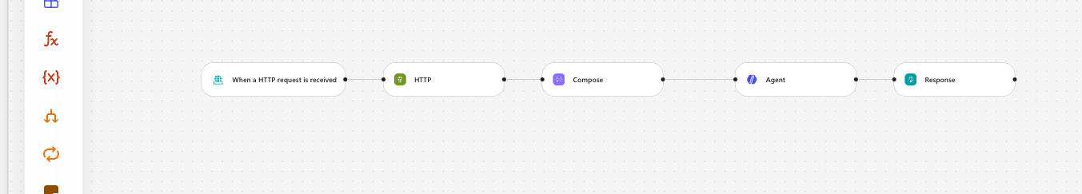
WHAT IT LOOKS LIKE WHEN FINISHED
The Flow on the Canvas
Published, five nodes, no “Needs setup” badges.
LU3 · Activity 3
© 2026 Tertiary Infotech Academy Pte Ltd
24

Slide 25
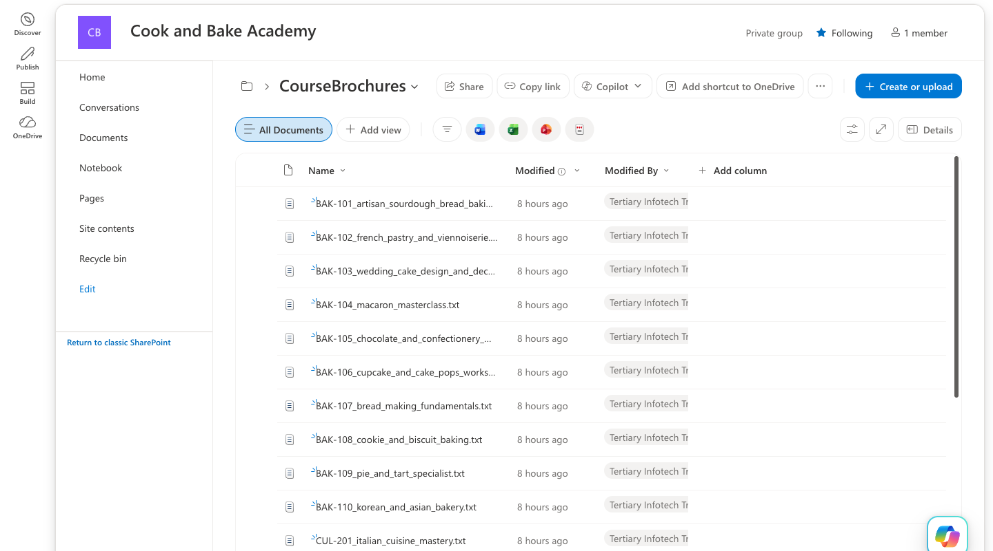
WHERE THE TRUTH LIVES
Task 0 — The Brochures in SharePoint
Create a NEW site — do not reuse another lab's.
The search and knowledge connectors index at folder level. Point a course assistant at a library that also holds banking policy and it will answer a sourdough question out of a KYC document.
Confirm the library shows 20 items. Nineteen means one upload silently failed — and that course becomes an “I don't have that” you will blame on the agent.
LU3 · Activity 3
© 2026 Tertiary Infotech Academy Pte Ltd
25

Slide 26
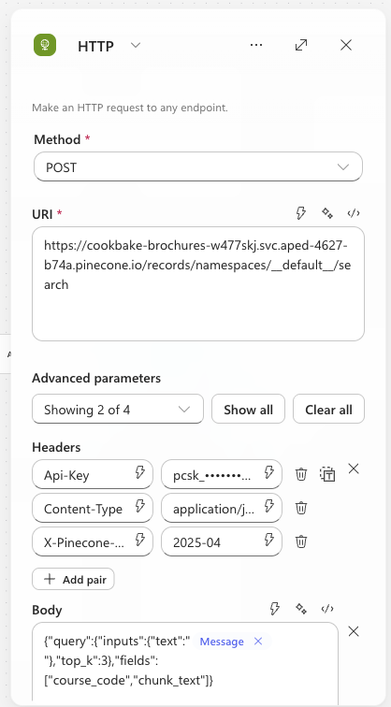
THE FIRST HALF OF RAG
Task 2 — The HTTP Node: Retrieval
Method is a SEPARATE dropdown — do not type POST into the URI.
__default__ is literal. Pinecone's default namespace is "" in its stats but __default__ in the URL path.
Three headers. Paste the KEY, not the words PINECONE_API_KEY — Power Automate cannot read a .env file.
The key goes in Headers, never in Authentication.
Body sends the question as plain text. Pinecone embeds it server-side.
LU3 · Activity 3
© 2026 Tertiary Infotech Academy Pte Ltd
26

Slide 27
BUILDING THE PROMPT
Task 3 — The Compose Node
1
The Agent node has NO input field
Only Instructions. So the per-question data has to be assembled somewhere else, and referenced from there.
2
concat() glues three things together
The customer's question, a label, and the retrieved brochures.
3
string() does the escaping
The HTTP response is JSON full of quotes and newlines. string() turns it into safe text. Without it the prompt breaks.
4
It is also your debugger
Compose's output appears in the run history — so you can see exactly what the agent was given, which is how you diagnose an empty answer.
concat('Customer question: ', triggerBody()?['message'], '\n\nCourse brochures:\n', string(body('HTTP')))
LU3 · Activity 3
© 2026 Tertiary Infotech Academy Pte Ltd
27

Slide 28
THE SECOND HALF OF RAG
Task 4 — The Agent Node: Generation
1
Instructions carry the rules, not the facts
Answer only from the brochures. Never invent a fee, date, duration, code, instructor or discount. Say so when you do not know.
2
Then insert the Compose reference with the ⚡ picker
Put the cursor at the end of the instructions and pick Compose → Outputs from the dynamic content tree. A blue chip appears.
3
NEVER paste an expression into Instructions
It is a rich-text editor. Pasted references are stored as plain text or have their underscores escaped.
4
A broken reference resolves to EMPTY, not an error
The node stays green, the run succeeds, and the agent silently receives nothing at all.
Symptom: the agent replies “the course brochures weren't included in your message”. It is telling you exactly what is wrong, in the one place nobody looks.
LU3 · Activity 3
© 2026 Tertiary Infotech Academy Pte Ltd
28

Slide 29
A reference to nothing
resolves to empty — not an error.
Green node. Successful run. No answer. This one failure mode costs more debugging time than every other mistake in this lab combined.
LU3 · Activity 3
© 2026 Tertiary Infotech Academy Pte Ltd
29

Slide 30
GETTING THE ANSWER BACK TO THE BROWSER
Task 5 — The Response Node
1
Status code 200, body { "reply": … }
The chat widget reads data.reply. A different shape shows [object Object] in the bubble.
2
The field is called Agent Response — not text
Use the ⚡ picker. Typing body/text yields an empty string with no error, and the flow looks broken for reasons unrelated to RAG.
3
Then PUBLISH — not just Save
The HTTP endpoint serves the PUBLISHED version. Check ⋯ → Version history: LIVE and CURRENT DRAFT must match.
4
Copy the HTTP POST URL from the trigger
It ends with sig=… — if that is missing, the URL was truncated on copy and every call will fail.
LU3 · Activity 3
© 2026 Tertiary Infotech Academy Pte Ltd
30

Slide 31
04
The Same Bot, Without the Vector Store
Lab 3a — a built-in knowledge base
LU3 · Activity 3
© 2026 Tertiary Infotech Academy Pte Ltd
31

Slide 32
In Copilot Studio,
RAG is not a node.
No ingestion workflow. No embedding model. No vector store. No chunk size. No top_k. Attach a SharePoint folder to the Agent node and retrieval simply happens.
LU3 · Activity 3
© 2026 Tertiary Infotech Academy Pte Ltd
32

Slide 33
THE ENTIRE FLOW
Lab 3a — Three Nodes
Trigger
Agent
Response
the question
arrives
searches Knowledge,
then answers
{ reply }
back to browser
Lab 3b needed five nodes, a Python ingestion script, a Pinecone index and an API key. Everything in the middle collapsed into one setting on the Agent node.
LU3 · Activity 3
© 2026 Tertiary Infotech Academy Pte Ltd
33

Slide 34
WHERE THE WORK WENT
What Replaced the Ingestion Half
1
Upload the 20 brochures to SharePoint
A folder called CourseBrochures. That is the ingestion step — there is no script and nothing to run.
2
Point the Agent's Knowledge at that folder
Knowledge → + → SharePoint → paste the folder URL. There is no file upload in the picker; SharePoint is the only route in.
3
Wait for SharePoint to index
Minutes, not seconds, and there is no progress bar. A source that is still indexing returns nothing, and the agent looks broken when it is merely empty.
4
Change the instruction wording
Lab 3b says "the brochures provided below". Nothing is provided below here — the agent must SEARCH. This one line is the whole difference, and getting it wrong costs an afternoon.
Point at the FOLDER, not the library root — a shared root will answer a sourdough question out of a banking policy.
LU3 · Activity 3
© 2026 Tertiary Infotech Academy Pte Ltd
34

Slide 35
An empty answer means the
instruction premise is wrong.
Lab 3a built by copying Lab 3b inherits "answer using only the brochures provided below" — with nothing below it. The agent is told its only source is empty, so it returns nothing at all. Not even a refusal. The run is green and takes 25 seconds.
LU3 · Activity 3
© 2026 Tertiary Infotech Academy Pte Ltd
35

Slide 36

LAB 3A, IN THE BROWSER
Same Question. Same Answer. No Vector Store.
The customer asks the same TC1 question and gets the same grounded answer — BAK-101, SGD $680, 4 weeks, the early-bird discount.
Behind this reply there is no Pinecone index, no ingestion script, no API key and no embedding model. Just a SharePoint folder attached to the Agent node.
Nothing about the page changed. Nothing about the agent's rules changed. You replaced the entire retrieval half and the chatbot did not notice — which is the debrief question worth asking.
LU3 · Activity 3
© 2026 Tertiary Infotech Academy Pte Ltd
36

Slide 37
THE DECISION THIS LAB EXISTS TO INFORM
Built-in Knowledge Base vs External Vector Store
Built-in knowledge base (Lab 3a)
External vector store (Lab 3b)
+ Three nodes. No ingestion, no API key, no index.
+ Nothing to mismatch — no dimension, no second model.
+ Re-crawls on its own when a document changes.
+ Permissions follow SharePoint.
− No chunk size, no top_k, no model, no metric.
− Citation markers leak into the reply.
− Indexing you cannot observe or trigger.
+ You own all four levers.
+ Portable — the same index serves n8n or a script.
+ Retrieval is inspectable in the run history.
+ Scales past a document library.
− Five nodes, a script, an API key, an index.
− Four new failures: dimension, credential, namespace, name.
− A changed document needs a RE-INGEST.
Choose by asking who maintains it. Levers you never pull are pure cost; levers you need and do not have are a rebuild.
LU3 · Activity 3
© 2026 Tertiary Infotech Academy Pte Ltd
37

Slide 38
NOT A TIE — IT DEPENDS ON THE QUESTION
When Each One Is The Right Answer
Reach for the built-in knowledge base
Reach for an external vector store
The documents already live in SharePoint, and someone already maintains them.
The corpus is small — tens to low hundreds of documents.
Nobody on the team wants to own a database.
Document permissions matter and must be inherited.
You need it working this afternoon.
Retrieval quality is the product, and you will need to tune it.
The corpus is large, growing, or not in Microsoft 365 at all.
The same knowledge must serve more than one application.
You need to see exactly what was retrieved for a given answer.
Audit rules demand a reproducible pipeline.
The honest default for a 20-brochure FAQ is the built-in one. Lab 3b exists so you know what you gave up.
LU3 · Activity 3
© 2026 Tertiary Infotech Academy Pte Ltd
38

Slide 39
THE FOUR HIDDEN DECISIONS
What the Convenience Actually Cost
1
Chunking — the biggest lever, now invisible
Lab 3b keeps each brochure whole, so one hit returns the code, fee, duration and campus together. Lab 3a chunks however it likes, and you cannot see or change it.
2
top_k — how many documents reach the prompt
Lab 3b sets 3. Lab 3a decides for you. When TC6 answers about macarons and goes quiet about cookies, retrieval returned one document — and there is no setting to raise.
3
The embedding model and its dimension
Lab 3b: llama-text-embed-v2, 1024, printed by the ingestion script. Lab 3a: unknown, unstated, unchangeable.
4
What you can do when it answers badly
Lab 3b gives you four levers. Lab 3a gives you the prompt. That is the entire difference, and it only shows up on the day it retrieves the wrong brochure.
Neither is wrong. But you cannot make this trade knowingly unless you have built both — which is why this lab has two halves.
LU3 · Activity 3
© 2026 Tertiary Infotech Academy Pte Ltd
39

Slide 40
05
CORS
Why the browser blocks an answer the flow already sent
LU3 · Activity 3
© 2026 Tertiary Infotech Academy Pte Ltd
40

Slide 41
THE RULE THAT SURPRISES EVERYONE ONCE
What CORS Is
1
A webpage may not read a response from another origin
Origin = scheme + host + port. A page on localhost:8000 calling *.powerplatform.com is cross-origin, and the browser polices it.
2
The SERVER decides, the BROWSER enforces
The server must send Access-Control-Allow-Origin. If it does not, the browser discards a response it already received.
3
Only browsers care
curl, Postman and your flow's own HTTP node ignore CORS entirely. That is why a curl test can pass while the web page fails.
4
The tell-tale pair
"Failed to fetch" in the page + a GREEN run in Activity. The request arrived, the flow worked, the answer was blocked on the way back.
CORS protects the USER from a malicious page reading their data elsewhere — it is not about protecting your flow.
LU3 · Activity 3
© 2026 Tertiary Infotech Academy Pte Ltd
41

Slide 42
WHAT THE BROWSER DOES FIRST
Preflight — The Request Before The Request
OPTIONS
204 + headers
POST
Response
browser asks:
may I POST here?
server replies:
allow-origin
only now does the
real request go
read only if the
headers allowed it
A POST with Content-Type: application/json always triggers preflight. If OPTIONS fails, your POST never happens at all.
LU3 · Activity 3
© 2026 Tertiary Infotech Academy Pte Ltd
42

Slide 43
VERIFIED AGAINST A LIVE TENANT
CORS In This Lab — Measured, Not Assumed
The old advice was wrong
So what you can actually do
For years the guidance was: “Power Automate sends no CORS header — serve the page from SharePoint.”
Tested with curl — OPTIONS <flow url>, Origin: null
→ 204
→ access-control-allow-origin: *
→ access-control-allow-headers: content-type
And Origin: null IS what file:// sends.
Double-click index.html. It works.
No local web server. No SharePoint hosting. No proxy. No browser flags.
Never disable web security to make a lab work — it is global, and here there was nothing to work around.
Classic Power Automate (*.logic.azure.com) may still differ — check the host, then test.
LU3 · Activity 3
© 2026 Tertiary Infotech Academy Pte Ltd
43

Slide 44
“Failed to fetch” plus a green run
is a diagnosis, not a mystery.
The request arrived and the flow ran. Only the reply was blocked. Before blaming CORS, check the two cheaper causes: the URL lost its sig= on copy, or the flow was saved but never Published.
LU3 · Activity 3
© 2026 Tertiary Infotech Academy Pte Ltd
44

Slide 45
06
Testing
Try to make it lie
LU3 · Activity 3
© 2026 Tertiary Infotech Academy Pte Ltd
45

Slide 46
TC1
It Works — A Grounded Answer
Course code BAK-101. Fee SGD $680. Duration 4 weeks. Intakes Jan, Apr, Jul, Oct. The 10% early-bird discount. The enrolment phone and email.
Every one of those facts is in the brochure. None came from the model's own training.
Round trip: about 15 seconds. Set expectations in class — this is not a database lookup.
LU3 · Activity 3
© 2026 Tertiary Infotech Academy Pte Ltd
46

Slide 47
SAMPLE-QUESTIONS.CSV
Ten Test Cases
CASE
QUESTION
A GOOD ANSWER
TC1
How much is the sourdough course?
BAK-101 + exact fee
TC2
How long is the French Pastry course?
BAK-102 + duration
TC3
Where are your campuses?
Both, with addresses
TC4
Cooking courses for beginners?
Two or three, not twenty
TC5
What is CUL-203 about?
Sushi & Sashimi + curriculum
TC6
Cheaper — macarons or cookies?
Both fees + which
TC7
Vietnamese pho course?
WE DON'T RUN THAT
TC8
Who teaches the macaron class?
NOT IN OUR INFORMATION
TC9
The 40% alumni discount on sushi?
DOES NOT CONFIRM IT
TC10
Recommend a restaurant?
Declines, steers back
The first six prove retrieval works. The last four are the ones that matter.
LU3 · Activity 3
© 2026 Tertiary Infotech Academy Pte Ltd
47

Slide 48
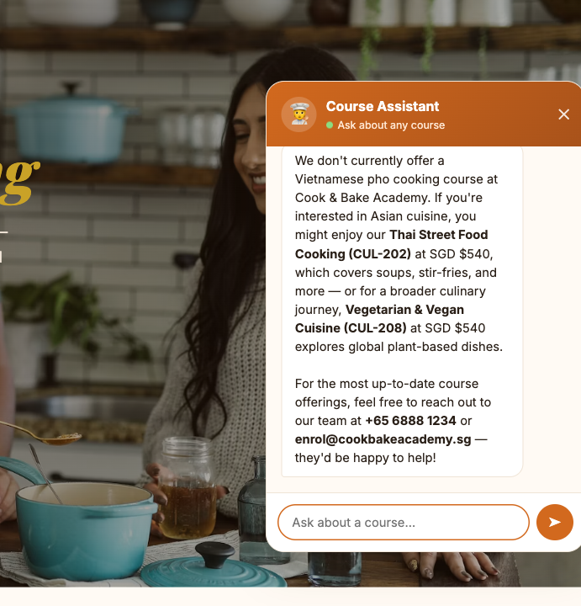
THE SLIDE THAT JUSTIFIES THE LAB
TC7 — The Agent Refuses to Invent
Asked for a course the academy does not run.
It says so plainly — then offers CUL-202 Thai Street Food and CUL-208 Vegetarian & Vegan, with their real fees.
An ungrounded model would have invented a pho course, a fee and a schedule. Fluently. And the customer would have quoted it back to you.
Retrieval alone would not have produced this. The instruction “if we do not run a course, say so plainly” is what turns a weak match into an honest refusal.
LU3 · Activity 3
© 2026 Tertiary Infotech Academy Pte Ltd
48

Slide 49
ADVERSARIAL TESTING
The Three Probes, and Why They Are Different
TC7 — a thing that does not exist
TC8 — a fact in no brochure
TC9 — a false premise
Invites the model to invent a course. Easy to resist, because nothing in the brochures resembles it.
Instructors are not in the course information. The model must distinguish “not retrieved” from “does not exist”.
The nastiest. The question ASSUMES a 40% discount exists. A model that wants to be helpful confirms it.
Any confident answer to these is a failure, however fluent. If yours invents an instructor, do not add instructors to the brochures — fix the instruction, then ask what else it might invent.
LU3 · Activity 3
© 2026 Tertiary Infotech Academy Pte Ltd
49

Slide 50
WHY RETRIEVAL ALONE IS NOT ENOUGH
Grounding: The Four Lines That Do the Work
What retrieval gives you
What the instruction must add
The three most similar brochures.
That is all. It is a search engine, not a conscience.
It always returns something — even when nothing fits.
A weak match still looks like a match.
Answer ONLY from the brochures below.
If they do not answer it, say “I don't have that”.
Never invent a fee, date, duration, code, instructor or discount.
If we do not run a course, say so, then list the closest.
Retrieval supplies the facts. The instruction forbids everything else. Ship one without the other and you have a confident liar or a useless one.
LU3 · Activity 3
© 2026 Tertiary Infotech Academy Pte Ltd
50

Slide 51
07
Debrief
What you built, and what it cost
LU3 · Activity 3
© 2026 Tertiary Infotech Academy Pte Ltd
51

Slide 52
THE PRICE OF CONVENIENCE
What the Platform Chose For You
1
Embedding model — llama-text-embed-v2
You never picked one. Change it and every stored vector becomes meaningless until you re-ingest.
2
Dimension — 1024
Fixed when the index was created. You cannot change it; you create a new index.
3
Chunking — one brochure, one record
The single most consequential setting in the system, decided at upload time, invisible afterwards.
4
Retrieved count — top_k: 3
The one knob you did turn. Set it to 1 and comparisons fail; set it to 20 and you are back to pasting the catalogue.
This is a genuine feature and a genuine cost: you cannot tune what you cannot see.
LU3 · Activity 3
© 2026 Tertiary Infotech Academy Pte Ltd
52

Slide 53
DEBRIEF
Five Questions for the Room
CASE
QUESTION
A GOOD ANSWER
1
The bot said “I don't have that” for TC8
Good answer or bad?
2
top_k is 3 — try 1, then 20
Which failure is worse?
3
Change a fee and re-ingest
Who owns accuracy now?
4
LU1 matched an NRIC exactly; this matches meaning
When do you choose which?
5
You never chose an embedding model
When does that stop being OK?
Question 3 is the one that changes how a team organises itself: the person who maintains the brochures now owns what the chatbot says.
LU3 · Activity 3
© 2026 Tertiary Infotech Academy Pte Ltd
53

Slide 54
HARD-WON, IN THIS ORDER
The Three Failures Worth Remembering
A reference that resolves to empty
The wrong output field
The key that was a variable name
Pasted into the rich-text Instructions box. Green node, successful run, no answer. Insert with the ⚡ picker, never paste.
Agent Response, not text. Guessing gives you an empty string and no error to explain it.
PINECONE_API_KEY pasted as the header VALUE. Power Automate cannot read a .env file. Unauthorized.
All three fail quietly. None of them is about RAG — and together they cost more time than the retrieval, the embedding and the grounding combined.
LU3 · Activity 3
© 2026 Tertiary Infotech Academy Pte Ltd
54

Slide 55
RAG changes the prompt,
not the model.
Retrieve the few documents that answer the question. Instruct the model to use nothing else. Then spend your testing time trying to make it lie.
LU3 · Activity 3
© 2026 Tertiary Infotech Academy Pte Ltd
55

